Slide 1
CARDS 202: D-38, OD-8, and External Reporting
CARDS Enhancements 2025
State of Nevada Workers’ Compensation Section (WCS)

Slide 2
CARDS 202: D-38, OD-8, and External Reporting
TRAINING MODULE
Supporting the CARDS 2025 Enhancements Release

Slide 3
Overview
Objectives
Training Course: CARDS 202: D-38, OD-8, and External Reporting
Audience: Insurer and TPA CARDS Users
Prerequisites: CARDS 201
Course Length: 1 hour
At the completion of this course, training participants will be able to add the NAICs code to a claim through the D-38, submit OD-8 webforms and understand how to access external reporting.

Slide 4
Modules
NAICs Code on the D-38 Webform
OD-8 Webform
External Reporting

Slide 5
NAICs Code Addition to the D-38 Webform
NAICS CODE ADDITION

Slide 6
NAICs Code on the D-38 Webform
Objectives
Navigation and Permissions
NAICS Code Addition to the Webform
At the completion of this module, training participants will be able to understand the addition of the NAICS Code on the D-38 webform and how to add the Code on a claim.
Notes:
TIP: Use this slide as the 2nd slide in each Module deck. If the module is broken down into sub-sections, then use this slide after each Section Divider.

Slide 7
D-38 Webform Permissions
Permissions to access the D-38 can be granted by an admin user selecting the “D-38 – Claims Indexing Form” option.

Slide 8
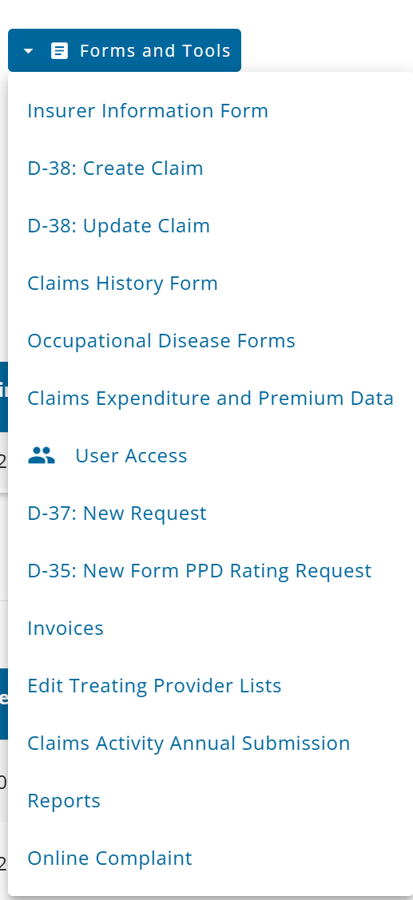
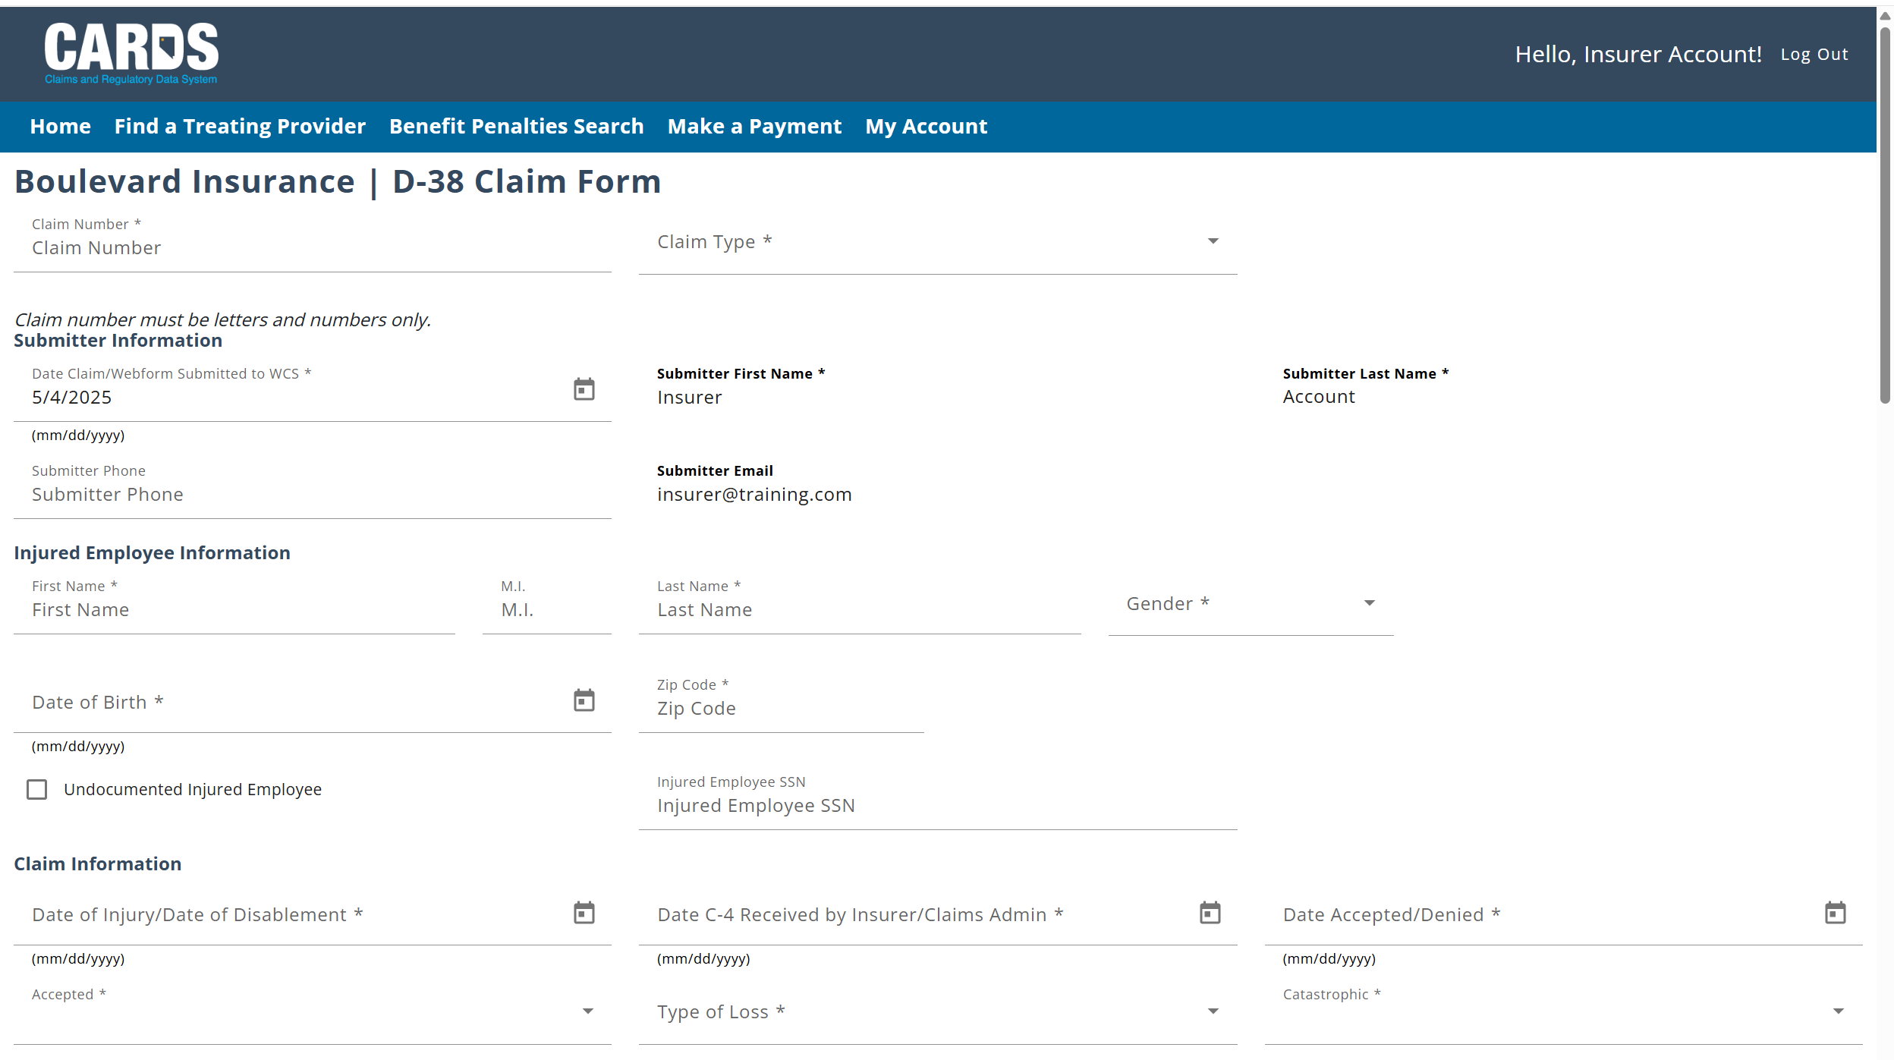
Navigating to the D-38
If you have the proper permissions granted by an account admin, the D-38 will be available from the Forms and Tools menu

Slide 9
Updates to the D-38 (Claims Indexing) Webform
ADDITION OF THE NAICS CODE
The D-38 webform has been updated to include a field for the NAICS (North American Industry Classification System) code.
An Employer may already have their NAICS code associated with their profile. Data is provided to the State by DETR (The Department of Employment, Training & Rehabilitation), on a quarterly basis to provide the related NAICS Industry Title and Code based on the FEIN of the employer. To search for the NAICS code on the employer, enter the FEIN of the Employer in the NAICS Lookup section. If a successful match is made, the user can then copy the information on the D-38.
Notes:
Note: Stress that no other functionality on the D-38 has changed, including how it is accessed.

Slide 10
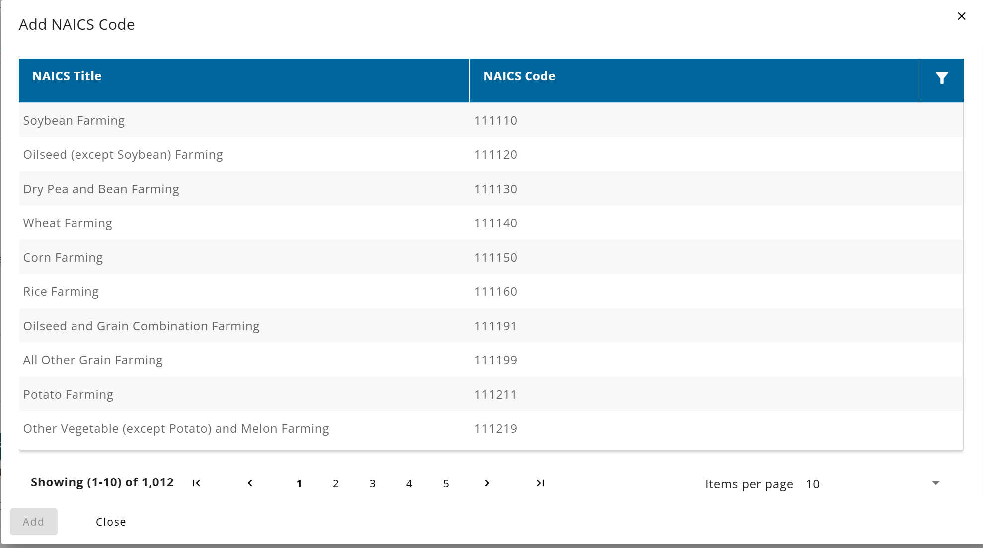
Updates to the D-38 (Claims Indexing) Webform
NAICS CODE LOOKUP
If the NAICS code does not exist on the Employer, the NAICS code can be added manually with the help of the NAICS Code Lookup modal. The user can select the “+ NAICS Code” button and filter on the different NAICS Industry to select the most appropriate industry for the Employer on the claim.
Notes:
Note: Stress that no other functionality on the D-38 has changed, including how it is accessed.

Slide 11
Questions?
CARDS 202: D-38, O-38, and External REPORTING
For any questions after this presentation, reach out to CARDS@dir.nv.gov
Notes:
Note: Replace the date placeholder with the date of the presentation to stakeholders and update contact information as necessary

Slide 12
OD-8 Webform
OCCUPATIONAL DISEASE REPORT
Notes:
To include the purpose of the insurer and TPA info forms, how to complete the form, update it, etc. Scenario where multiple people may need to go in and fill out their contact information

Slide 13
OD-8 Webform
Objectives
OD-8 webform overview
Navigation and permissions
At the completion of this module, training participants will be able to access and complete the OD-8 webform.
Notes:
TIP: Use this slide as the 2nd slide in each Module deck. If the module is broken down into sub-sections, then use this slide after each Section Divider.

Slide 14
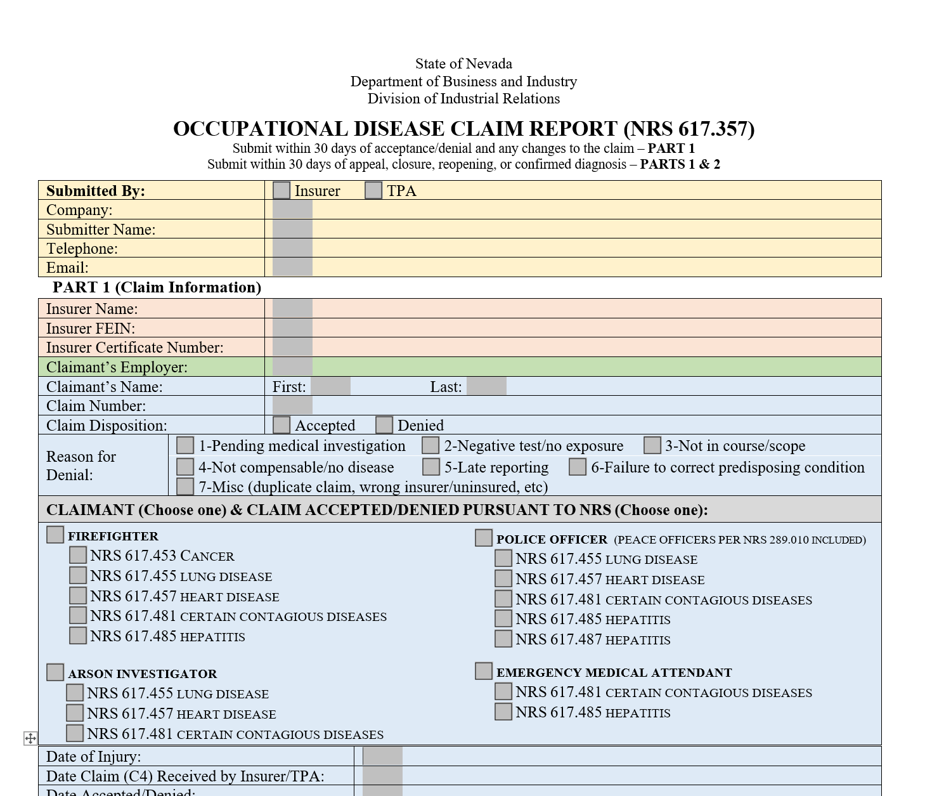
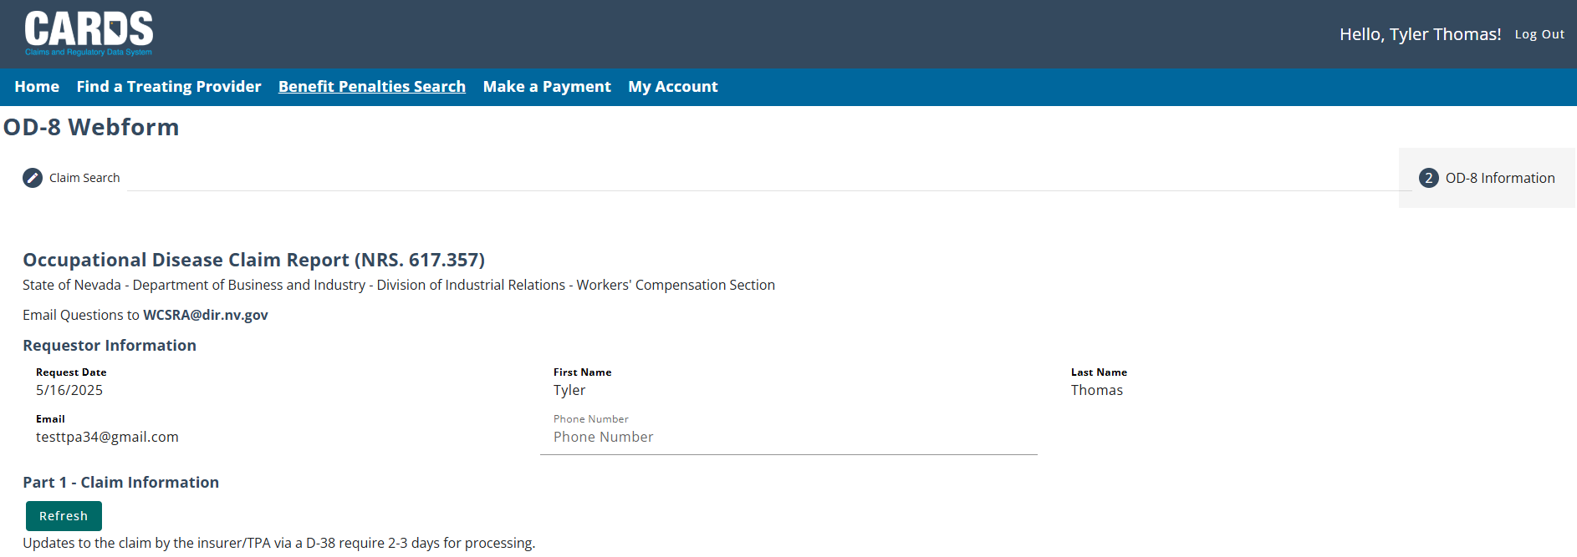
OD-8 (Occupational Disease) Webform
The CARDS enhancements include moving the OD-8 Webform paper submissions to an online webform. External users with the proper permissions will be able to search on an indexed claim to either submit an initial report, an update, or submit a statement of inactivity for the calendar year.

Slide 15
OD-8 Webform Permissions
Permissions to access the OD-8 can be granted by an admin user selecting the “D-38 – Claims Indexing Form” option.

Slide 16
Navigating to the OD-8 Webform
Users can select to Create a new OD-8, update an existing OD-8, or submit a Statement of Inactivity for the year.

Slide 17
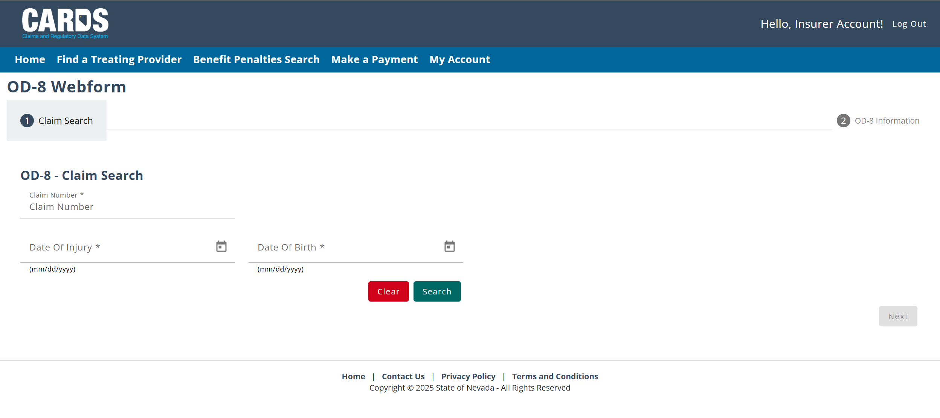
OD-8: Create Webform
The OD-8 webform has two parts, first the claim search page where the OD-8 is linked to a specific claim, followed by the information page. The claim must be an Approved Claim (internal approval by WCS) that is the “Occupational Disease (617)” Type of Loss.

Slide 18
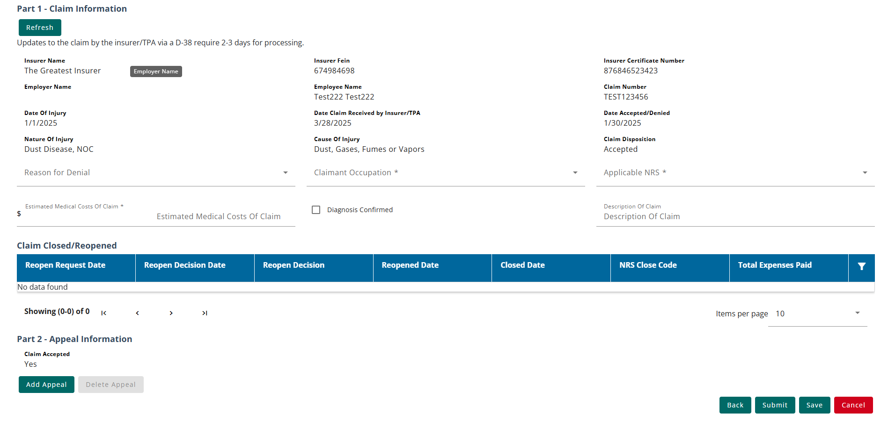
OD-8: Create Webform
Once a successful search has been completed, data related to the claim will prepopulate on the form, with a few additional fields to populate related to the OD-8 submission. Once you reach part two, you can fill out the form and submit or save the draft for later. Part 1 of the webform is required, regardless if completing an initial or update.

Slide 19
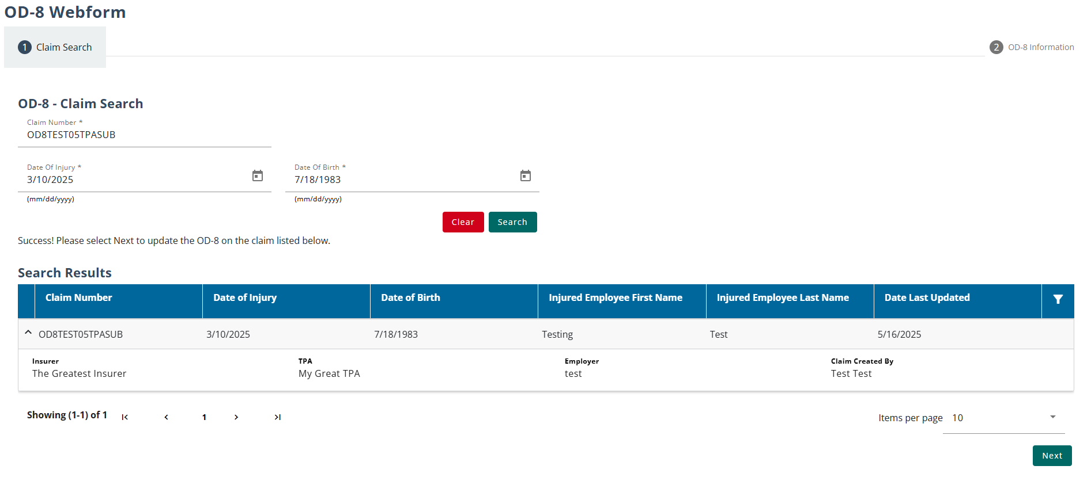
OD-8: Update Webform
If a claim already has an associated OD-8, external users will be required to submit an OD-8 Update webform. Using the search feature, the user can search on the claim where an OD-8 has already been created.

Slide 20
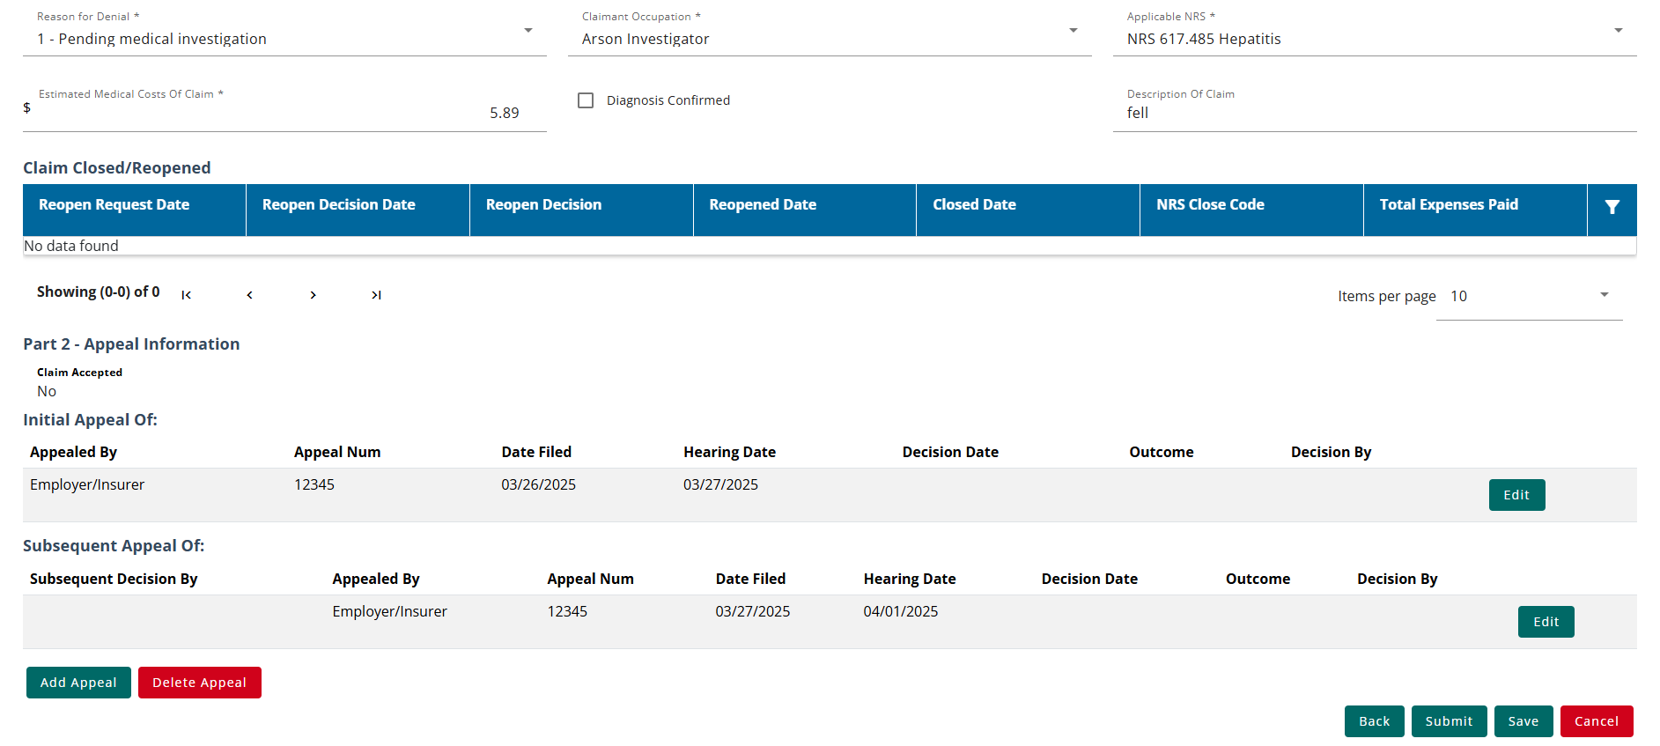
OD-8: Update Webform
Data that had been previously submitted on the OD-8 Create form will now be populated on the Update form, allowing the user to update the information as needed.

Slide 21
OD-8: Statement of Inactivity
A statement of inactivity can be submitted for a calendar year if there was no occupational disease claims activity. If a statement of inactivity has already been reported for the calendar year selected, a message with populate notifying the user.

Slide 22
OD-8: Statement of Inactivity
If a statement of inactivity has already been reported for the calendar year selected or an OD-8 webform had already been submitted, a message will populate on the screen notifying the user and preventing them from submitting the Statement of Inactivity.

Slide 23
Questions?
CARDS 202: D-38, O-38, and External REPORTING
For any questions after this presentation, reach out to CARDS@dir.nv.gov
Notes:
Note: Replace the date placeholder with the date of the presentation to stakeholders and update contact information as necessary

Slide 24
External Reporting
REPORTING ENHANCEMENTS
Notes:
How to access and complete the claims activity report webform, scenario in which form is needed to be filed, viewing the filing, etc.

Slide 25
External Reporting
Objectives
External reporting overview
Accessing reports
At the completion of this module, training participants will be able to access and utilize the external reporting feature in CARDS.
Notes:
TIP: Use this slide as the 2nd slide in each Module deck. If the module is broken down into sub-sections, then use this slide after each Section Divider.

Slide 26
External Reports
REPORT | INSURERS | TPAs
Claims Denial and Injury (NRS 616)/Occupational Disease (NRS 617) Report | ✓ | ✓
Claim Closure and Average Cost per Claim Report | ✓ | ✓
Claims Expenditure & Premium Data Report | ✓
Claims Activity Report | ✓ | ✓
Claims Report | ✓ | ✓
Invoices & Payments | ✓ | ✓
Complaints Report | ✓ | ✓
Occupational Disease (OD-8) Report | ✓
Subsequent Injury (D-37) Report | ✓
PPD Rating (D-35) Report | ✓ | ✓
REPORTS AVAILABLE TO INSURERS AND TPAS
For some reports, users need permissions granted to them by the account admin in addition to having the correct user type, including:
Claims Expenditure and Premium Data
Monetary Assessment Review (Invoices & Payments)
D-38 – Claims Indexing Form
Subsequent Injury
Notes:
Note: All of the attendees should have knowledge of how permissions can be set by admin users, but you may want to verbalize the process quickly here as a refresher.

Slide 27
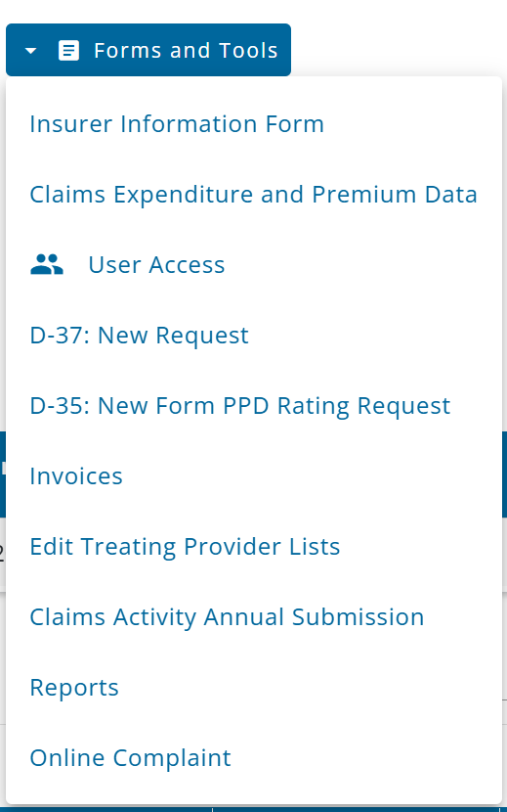
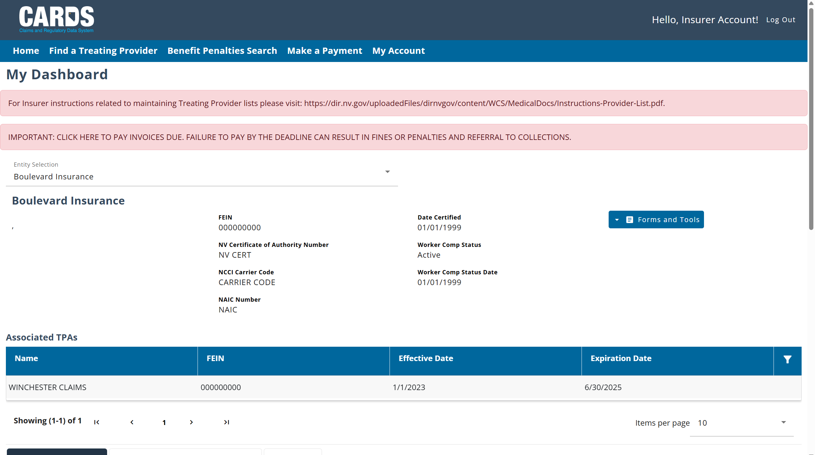
Navigating to External Reports
Reports can be found in the Forms and Tools menu.

Slide 28
Generating External Reports
Based on the report you wish to create, use the filters on the screen to select the report type. Additional filters can be applied depending on the type of report. In the example below, the user has selected to generate the Claims Report in an excel file, looking at the claims reported in the 2024 fiscal year based on Date of Injury.

Slide 29
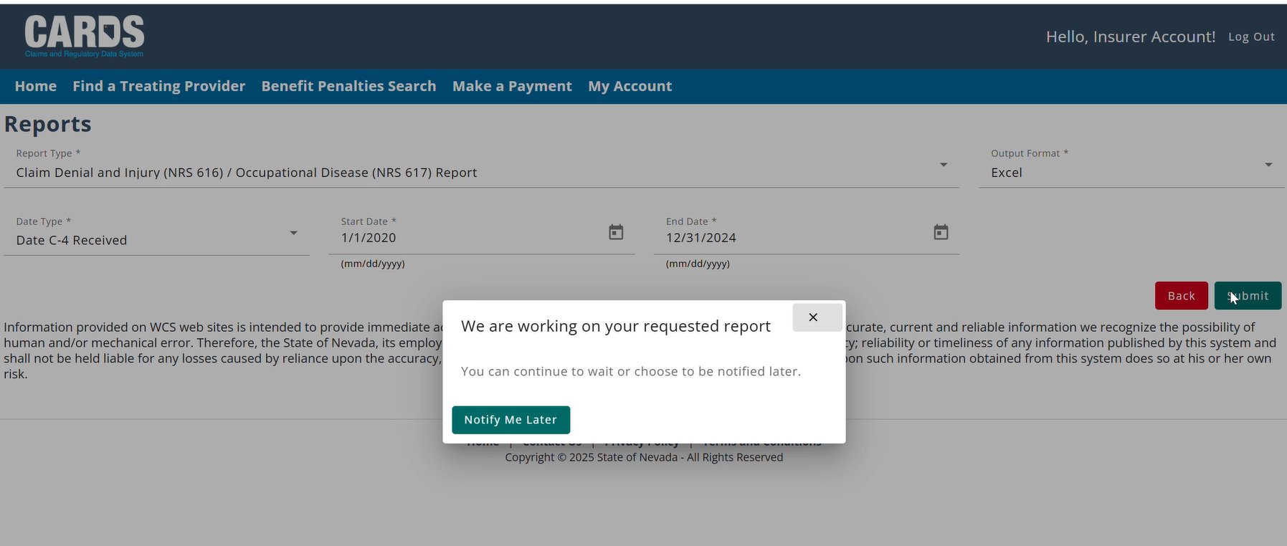
Downloading External Reports
Larger reports may take longer to download. If a report is taking a longer time to download, you can choose to be notified via email when it is ready.

Slide 30
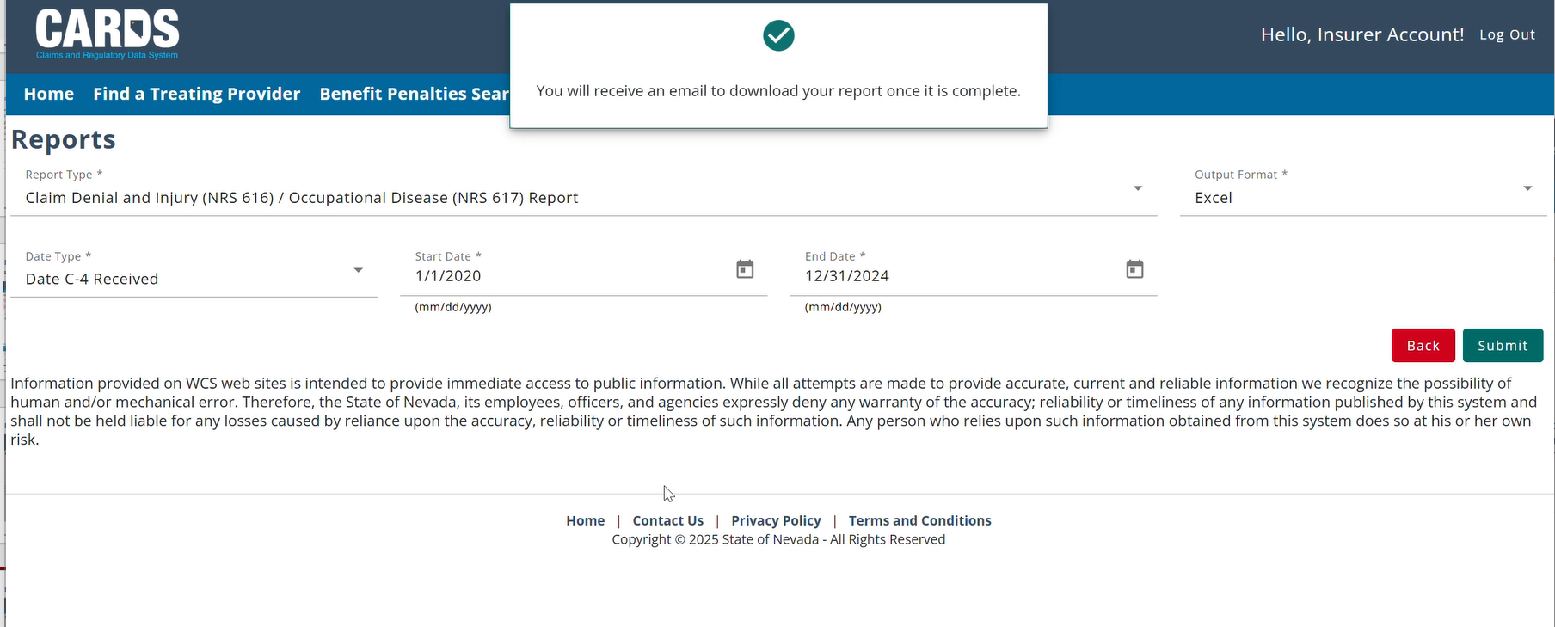
Downloading External Reports
Once you select “Notify Me Later” you will see a pop-up confirmation on your screen. The email will be sent to the email that your account is registered under.
Notes:
Note: Stress here the importance of making sure that users know what email their account uses (and that it is active) so that they are able to get the notification.

Slide 31
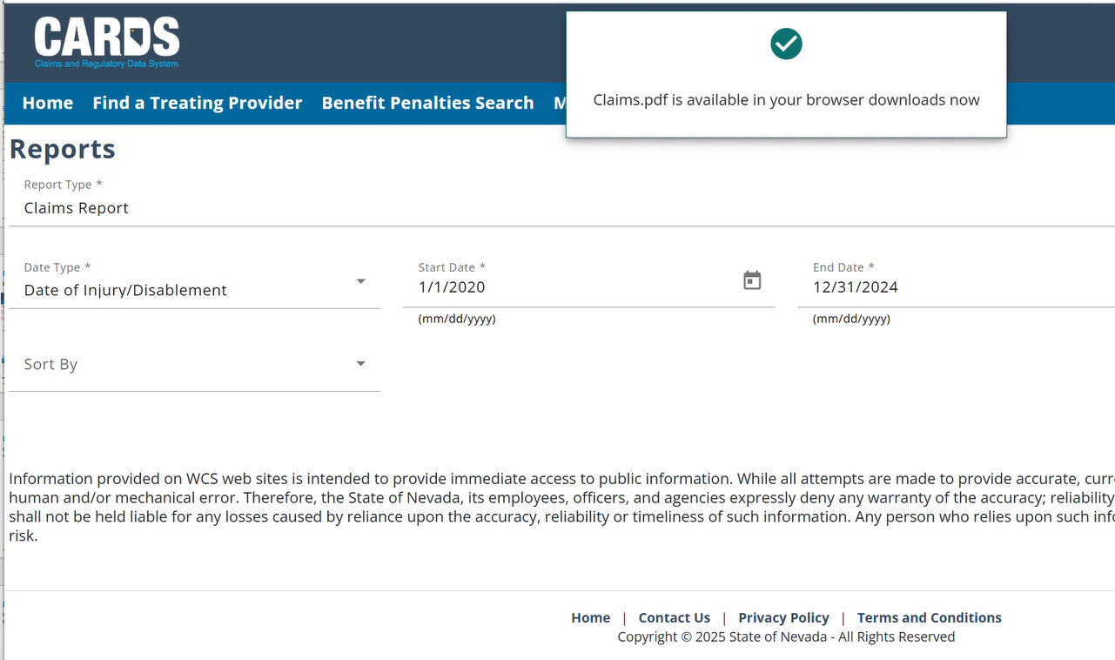
Downloading External Reports
Smaller reports tend to download more quickly. They will typically be saved to your “Downloads” folder.

Slide 32
Questions?
CARDS 202: D-38, O-38, and External REPORTING
For any questions after this presentation, reach out to CARDS@dir.nv.gov
Notes:
Note: Replace the date placeholder with the date of the presentation to stakeholders and update contact information as necessary

